Slide 1
2021 bond program update
February 7, 2022

Slide 2
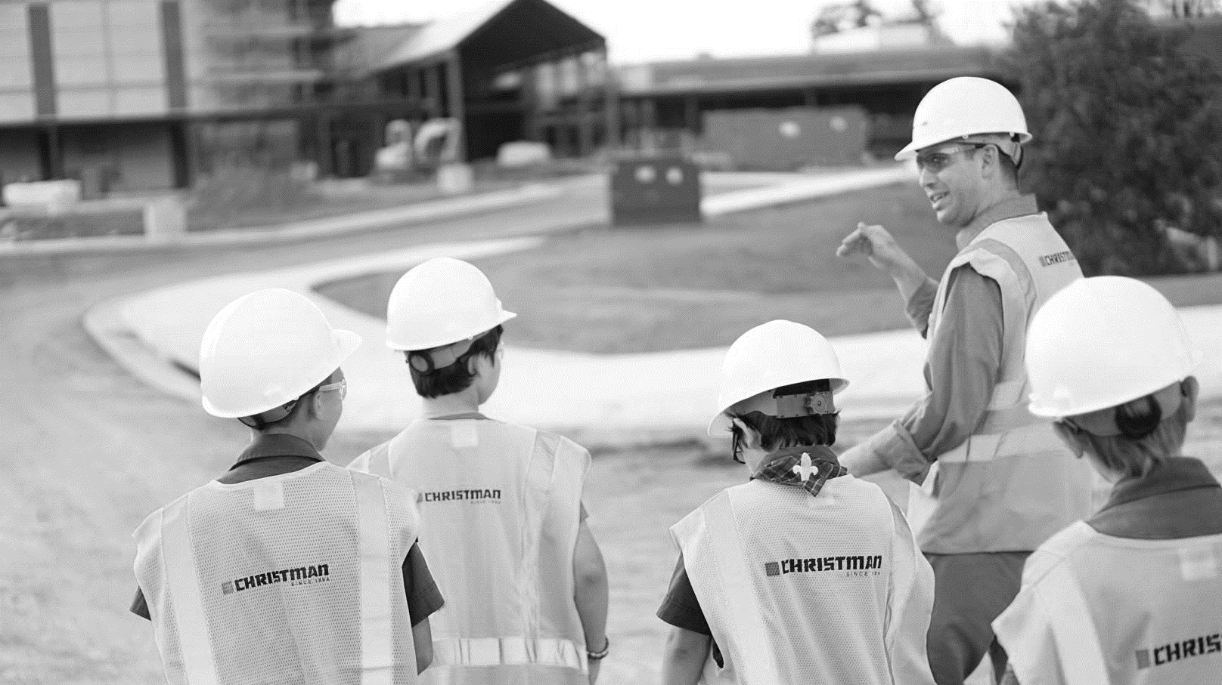
Construction Timeline
2
Notes:
To be updated, most recent timeline

Slide 3
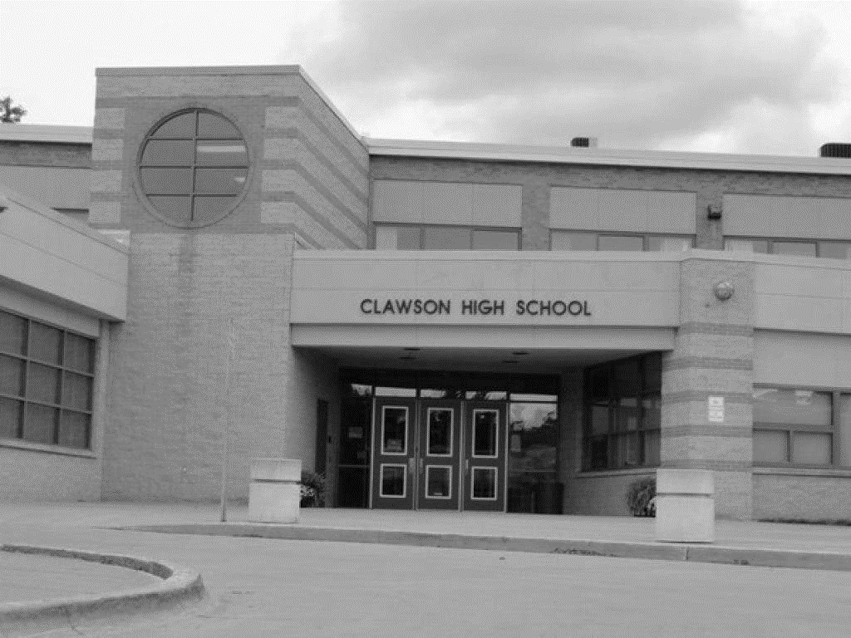
AGENDA
Design
Bidding
Procurement
Construction
Closeout

Slide 4
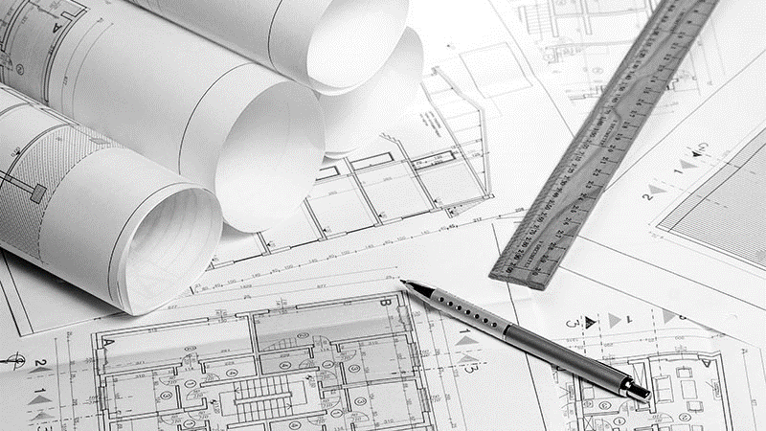
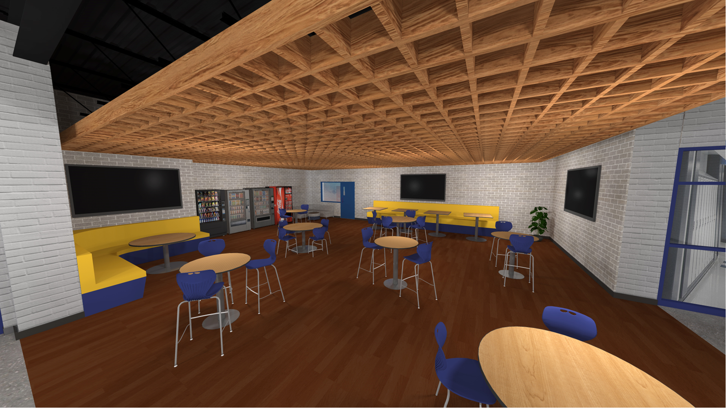
Design Update – Trojan Hall Revisions
4

Slide 5
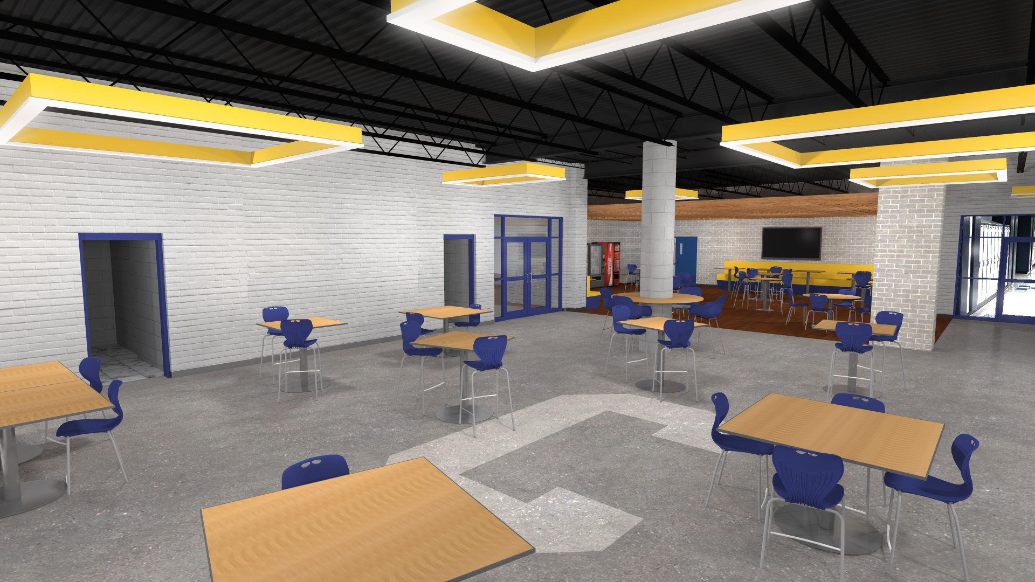
Design Update – Trojan Hall Revisions
5

Slide 6
Bidding Update
Work Packages for Bid
WC 02 - Site Work
WC 07 – Fencing
WC 10 – Concrete
WC 11 – Masonry
WC 12 – Structural Steel
WC 14 – Roofing
WC 15 – Metal Panels
WC 18 - Glass / Glazing
WC 20 – Carpentry / General Trades
WC 21 - Walls
WC 22 - Tile
WC 23 – Resilient Flooring
WC 24 – Painting
WC 27A – Mechanical
WC 27B – Plumbing
WC 27C - Controls
WC 28 – Electrical
WC 30 - Elevators
Bid Pack 2: Scope of Work - $9.7M
New Middle School Addition
High School Secure Entry
Rebid of Trojan Hall Finishes from Bid Package No. 1
6

Slide 7
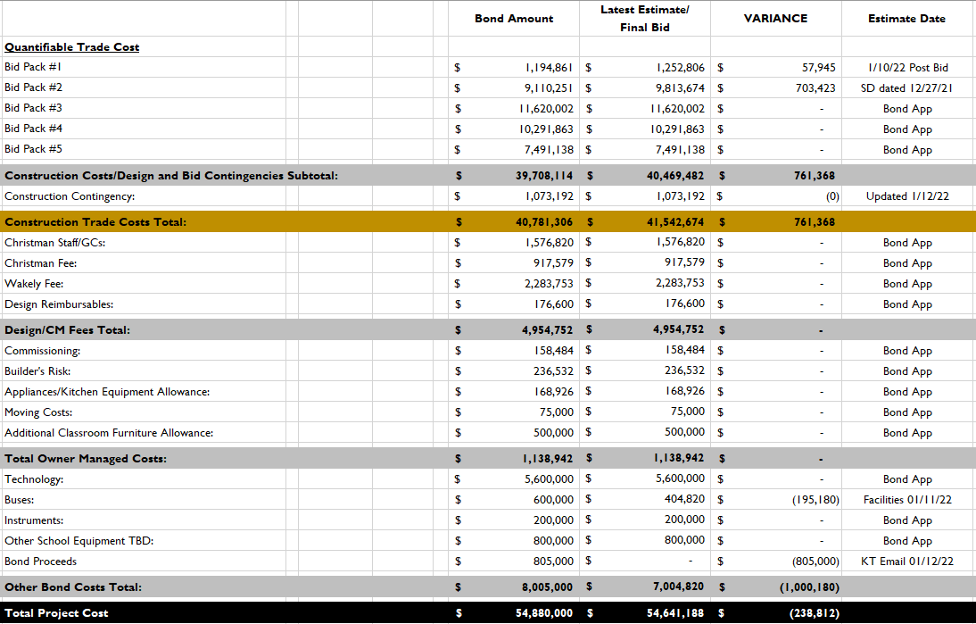
Bidding Update 01/17/22
7

Slide 8
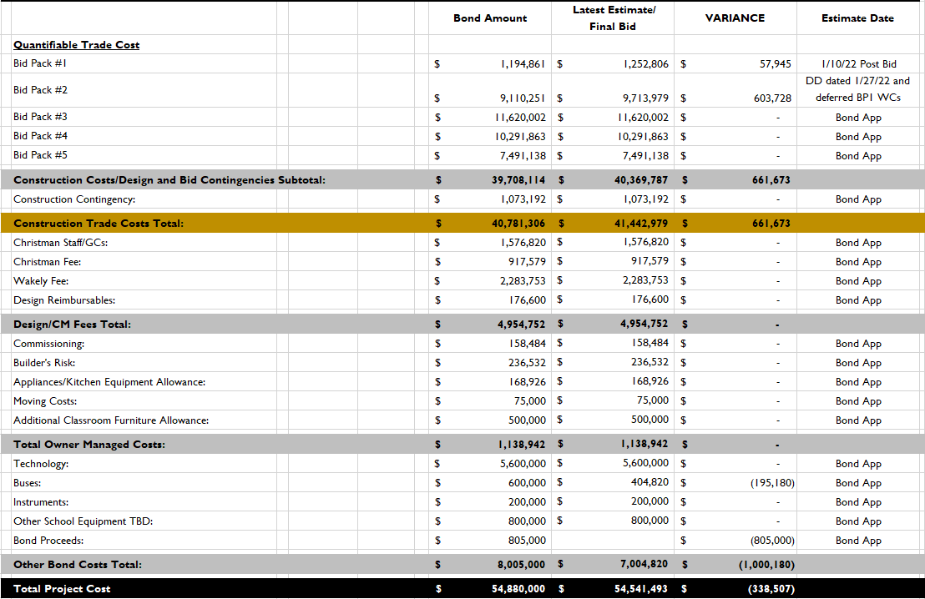
Bidding Update 02/01/22
8

Slide 9
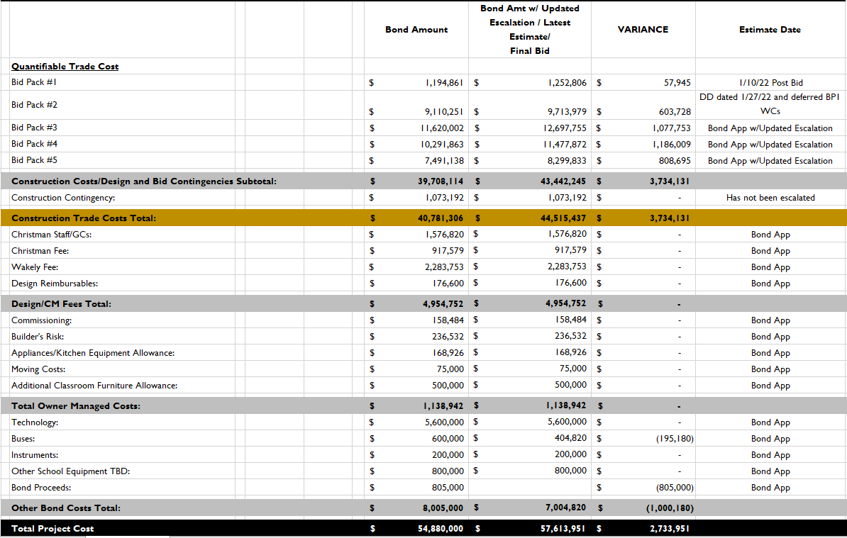
Bidding Update 02/01/22 with BP3-5 Escalation
9

Slide 10
Procurement Update
Anticipate Board approval Monday 02/07/22
Subcontracts Issued: 02/08/22 – 02/11/22
Submittal & Shop Drawing Period: 02/08/22 – 05/01/22
Fabrication & Delivery: 03/01/22 – 06/01/22
Start of Construction: 06/13/22
10

Slide 11
Open Discussion & Input

